Slide 1



AI-Powered Quantum Wellness: A Predictive Framework Integrating Yoga, Ayurveda & Indian Knowledge Systems for Human Optimization
Sugam Kumar, Chief Scientist,
Varenyam AI, Hyderabad, India
sociosugam@gmail.com

Slide 2
Introduction & Problem Context
Limited Effectiveness of Reactive Healthcare
Current healthcare systems primarily address symptoms after disease onset, resulting in escalating costs and suboptimal long-term outcomes for chronic conditions.
Escalating Lifestyle and Mental Health Burden
Global prevalence of lifestyle disorders and mental health conditions continues to rise, driven by sedentary behaviour, dietary imbalances, and psychosocial stressors.
Preventive Focus of Traditional Systems
Yoga and Ayurveda emphasize maintaining balance across physical, mental, and energetic dimensions through personalized lifestyle interventions and holistic self-care.
Scalability and Computational Gaps
Traditional knowledge systems lack standardized computational frameworks for large-scale deployment, personalized prediction, and quantitative outcome measurement.
Integration with Artificial Intelligence
AI enables processing complex multivariate data, modeling individual trajectories, and generating personalized wellness recommendations at scale.

Slide 3
Research Objectives & Significance
Integrated Framework Development
Sugam's Scale Design
Design a computational framework that synthesizes Yoga philosophy, Ayurvedic principles, and Indian Knowledge Systems with AI-driven predictive modeling.
Develop a multi-dimensional wellness index encompassing Fitness, Health, Productivity, and Happiness metrics with standardized measurement protocols.
Predictive Personalization
Traditional-Computational Bridge
Enable personalized, preventive wellness interventions through computational modeling of individual trajectories and risk factor identification.
Translate qualitative traditional knowledge into quantitative computational models, preserving holistic principles whilst enabling scientific validation.

Slide 4
Methodology & Framework
Sugam's Scale Dimensions
Fitness: Physical capability and metabolic efficiency
Health: Clinical biomarkers and disease risk profiles
Productivity: Cognitive function and task performance
Happiness: Psychological well-being and life satisfaction
Input Variables
Demographic: Age, gender, anthropometrics
Behavioural: Sleep, nutrition, physical activity
Psychological: Mood, stress, resilience
Tridosha: Vata, Pitta, Kapha constitution
Triguna: Sattva, Rajas, Tamas qualities
System Architecture
Data normalization and standardization
AI processing and feature extraction
Well-being index calculation
Deviation quantification
Recommendation engine generation

Slide 5
Mathematical Model
Well-Being Index
Where W represents the overall well-being index, w_i denotes dimension-specific weights derived from individual constitution, and F_i represents normalized scores across Fitness, Health, Productivity, and Happiness dimensions.
Deviation Metric
Where D quantifies deviation from natural state, S_n represents the individual's current wellness score, and S_c denotes their constitutionally optimal baseline. Positive values indicate improvement potential.

Slide 6




AI Integration & Simulation
Hybrid AI Architecture
Scenario Generation
Rule-based reasoning from Yoga and Ayurveda combined with machine learning for personalized pattern recognition.
Quantum-inspired simulation exploring Yoga-only (S₁), lifestyle-only (S₂), and integrated (S₃) intervention pathways.
Evaluation Metrics
Optimal Path Selection
Alignment with constitution, resistance to deviation, and long-term sustainability of behavioral changes.
Recommendation engine identifies S* as the most effective personalized intervention strategy.

Slide 7
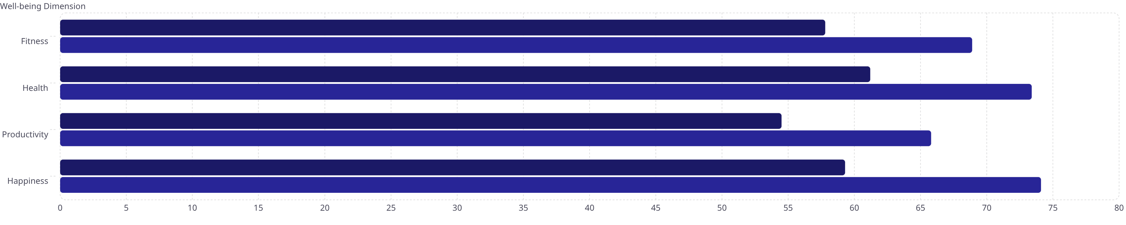


Results & Findings
Clinical Study Parameters
52
24
~70%
3-5%
Participants
Days
Adherence
Error
Sample size
Intervention duration
Protocol compliance
Prediction accuracy
Well-Being Score Improvements
Baseline
Post-Intervention
21%
30-45%
Well-being Index
Deviation Reduction
Overall improvement
From baseline

Slide 8
Discussion, Conclusion & Future Scope
Key Interpretations
Consistent improvements across all four wellness dimensions
Psychological well-being demonstrated fastest gains
High adherence correlated with improved outcomes
Prediction error remained within acceptable bounds
Research Contributions
First computational framework integrating Yoga, Ayurveda, and AI
Quantitative measurement model for traditional knowledge
Predictive wellness paradigm replacing reactive healthcare
Future Research Directions
Integration with wearable biosensors and IoT devices
Large-scale multi-center validation studies
Community health and institutional deployment models
Longitudinal analysis of sustained behavioral changes

